Slide 1
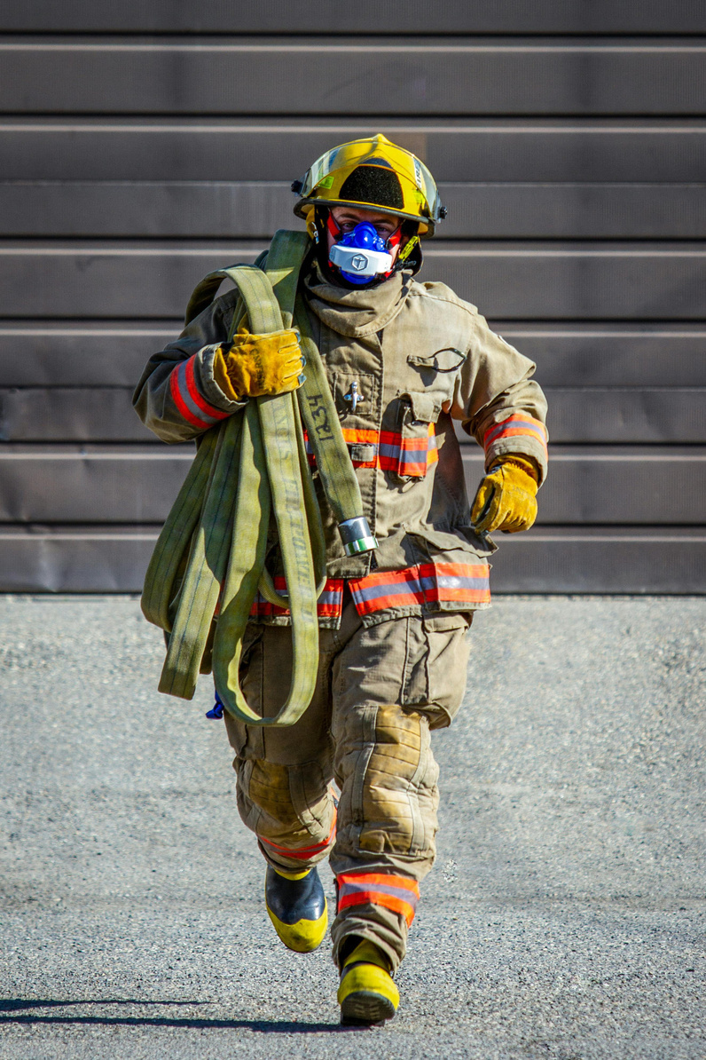


FIREFIGHTER GEAR CONTAMINATION & FIRE TRUCK PRICE FIXING LAWSUITS
Impacts on Municipal Budgets and Legal Recovery Option
Attorney Work Product. Privileged & Confidential.

Slide 2
Fire Truck Pricing Litigation
Attorney Work Product. Privileged & Confidential.

Slide 3
BACKGROUND & CRISIS OVERVIEW
KEY STATISTICS:
THE PROBLEM:
REAL EXAMPLE:
  Fire truck prices have doubled in 10 years (average pumper now exceeds $1 million, up from ~$500K)
  Wait times have increased from 18 months to over 4 years
  Market controlled by three manufacturers: Oshkosh/Pierce, REV Group (E-ONE, FERRARA, KME) , and Rosenbauer America
  Municipalities are forced to operate aging fire trucks 30+ years old (vs. 15-20 year expected lifespan)
  Increased breakdown frequency and difficulty obtaining replacement parts
  Public safety at risk due to gaps in fire protection systems
  Municipal budgets severely strained
  Oshkosh Fire Department purchased two identical engines in 2020 for $639,900 each
  In 2026, one nearly identical engine cost $1,142,085
  That’s nearly double in less than 4 years
Attorney Work Product. Privileged & Confidential.

Slide 4

THE ALLEGATIONS
A. CLAIMS:
C. THE MECHANISM
  Violation of Section 1 of the Sherman Antitrust Act - conspiracy to unreasonably restrain trade and commerce
  Violation of applicable State Antitrust Law
  Unjust Enrichment
  Manufacturers allegedly used FAMA to facilitate coordination
  FAMA collects economic data from manufacturers, sends to third-party consultant for compilation, then distributes reports back to members
  Annual meetings and ongoing communications allegedly allowed competitors to monitor each other’s decisions
  This coordination allegedly enabled them to move prices in lockstep
B. ALLEGED ANTICOMPETITIVE CONDUCT:
  Price Fixing - Coordination among competitors to artificially inflate fire truck prices
  Production Suppression - Deliberately restraining manufacturing output to create artificial scarcity and justify higher prices
  Market Manipulation - Using industry backlogs as justification for “floating prices” (retroactive price increases after orders are placed)
  Information Sharing - Exchange of confidential, competitively sensitive economic data through the Fire Apparatus Manufacturers’ Association (FAMA)
D. TIMELINE:
  Conspiracy allegedly dates back to at least 2016
  Coordinated conduct allegedly continues through 2025
Attorney Work Product. Privileged & Confidential.

Slide 5
THE DEFENDANTS
OSHKOSH CORPORATION (WISCONSIN)
ROSENBAUER AMERICA LLC (SOUTH DAKOTA)
  Owns Pierce Manufacturing subsidiary
  Approximately 25% of U.S. market share after recent acquisitions (2021-2022)
  One of the three dominant manufacturers
  One of the three dominant manufacturers
  Together with Oshkosh and REV Group, controls 70-80% of U.S. market
REV GROUP INC. (BROOKFIELD, WISCONSIN)
FIRE APPARATUS MANUFACTURERS’ ASSOCIATION (FAMA)
  Major manufacturer with significant market presence
  One of the three dominant manufacturers
  Trade association allegedly facilitating information exchange and coordination
  Accused of creating the platform for competitors to share confidential data
  Enabled monitoring of competitor pricing and production decisions
Attorney Work Product. Privileged & Confidential.

Slide 6
DAMAGES BEING SOUGHT
FINANCIAL REMEDIES
ADDITIONAL RELIEF
CLASS ACTION SCOPE
  Treble Damages - Under federal antitrust law, plaintiffs can recover triple damages (3x actual harm). This is mandatory under the Sherman Act to deter anticompetitive conduct.
  Overpayment Recovery - Compensation for inflated prices paid by municipalities since 2016
  Permanent Injunction - Court order to halt all alleged anticompetitive practices
  Legal Costs - Reimbursement of attorneys’ fees and litigation expenses
  Declaratory Relief - Judicial declaration that defendants violated antitrust laws
  These are proposed class actions
  SIGNIFICANT ACTION: April 4, 2026 most cases transferred to Eastern District of Wisconsin creating Multi District Litigation
  If certified, thousands of fire departments and municipalities who purchased fire trucks since 2016 could benefit from any settlement or judgment
Attorney Work Product. Privileged & Confidential.

Slide 7
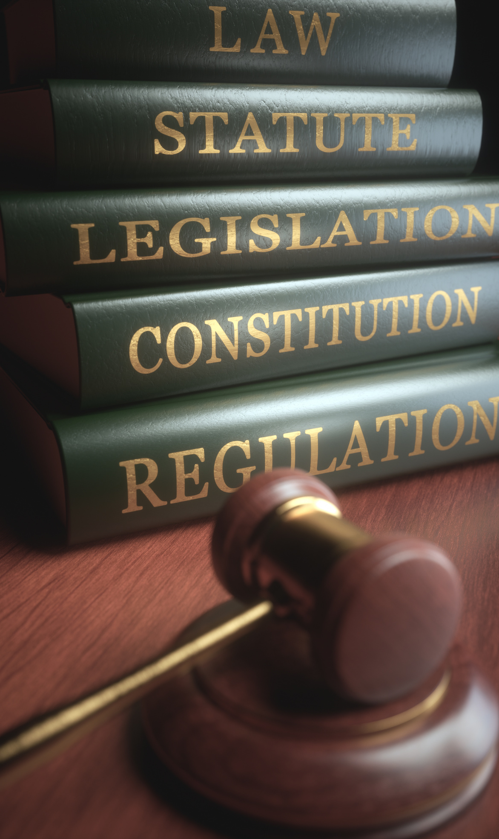
HOW TO FILE OR JOIN A LAWSUIT
WHO QUALIFIES:
DOCUMENTATION REQUESTED
1
Municipalities, fire departments, fire districts, or other government entities
Purchased fire trucks from any defendant since approximately 2016
Paid inflated prices as a result of the alleged conspiracy
1
Date of purchase or order
All purchase records from 2016 to present
Manufacturer and model purchased
Original quoted price vs. final price paid
Delivery timeline (quoted vs. actual)
Any “floating price” adjustments or retroactive increases
Documentation of operational impacts (aging equipment, safety concerns)
2
2
3
4
3
5
6
7
Attorney Work Product. Privileged & Confidential.

Slide 8
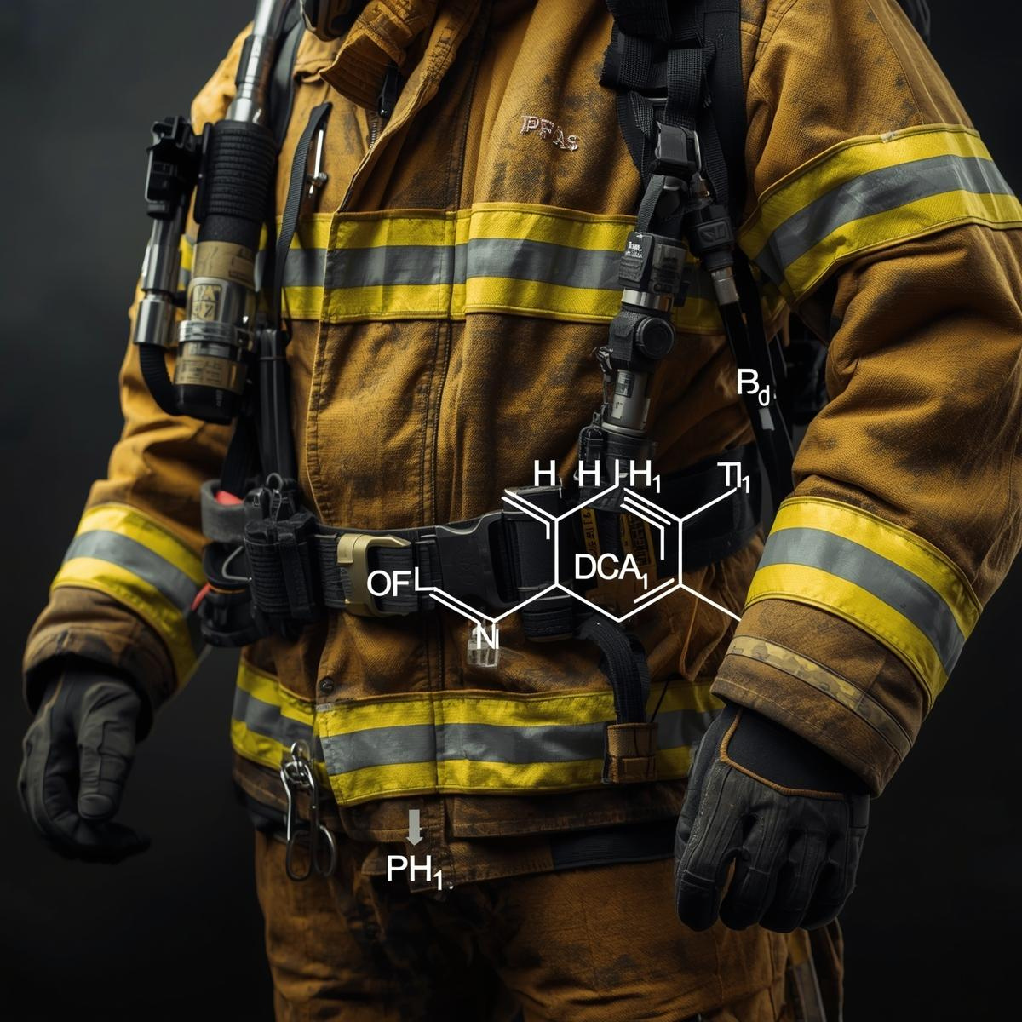
What are
PFAS chemicals?
Purpose of Presentation:
Explore legal options for recovery of monies spent on turn out gear.
WHY ARE THEY USED IN FIREFIGHTER TURNOUT GEAR?
PFAS are incorporated in turnout gear due to their chemical properties. Their durability, water resistance, and heat resistance make them well-suited for the outer layers of the gear, enabling it to repel water, oils, and other hazardous materials while withstanding high temperatures and flames.
However, the use of PFAS in turnout gear has sparked concerns over potential health risks as these substances can accumulate in the body and the environment.
Attorney Work Product. Privileged & Confidential.

Slide 9
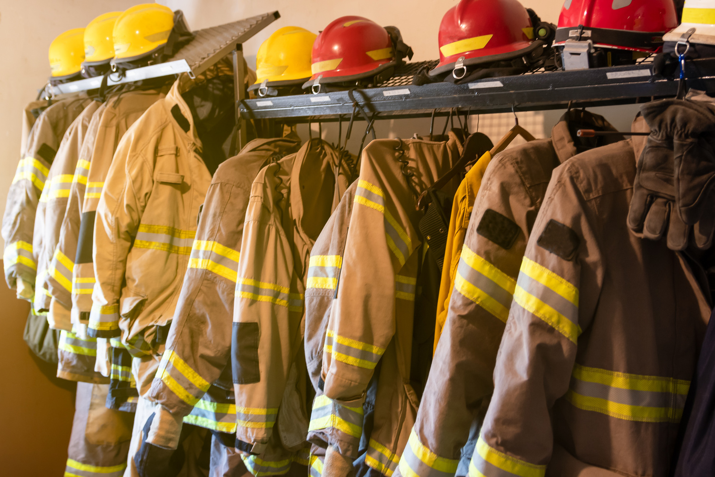
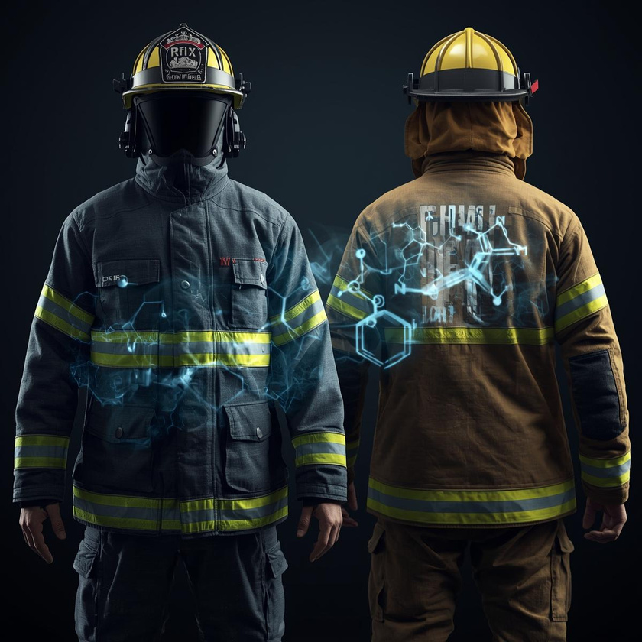

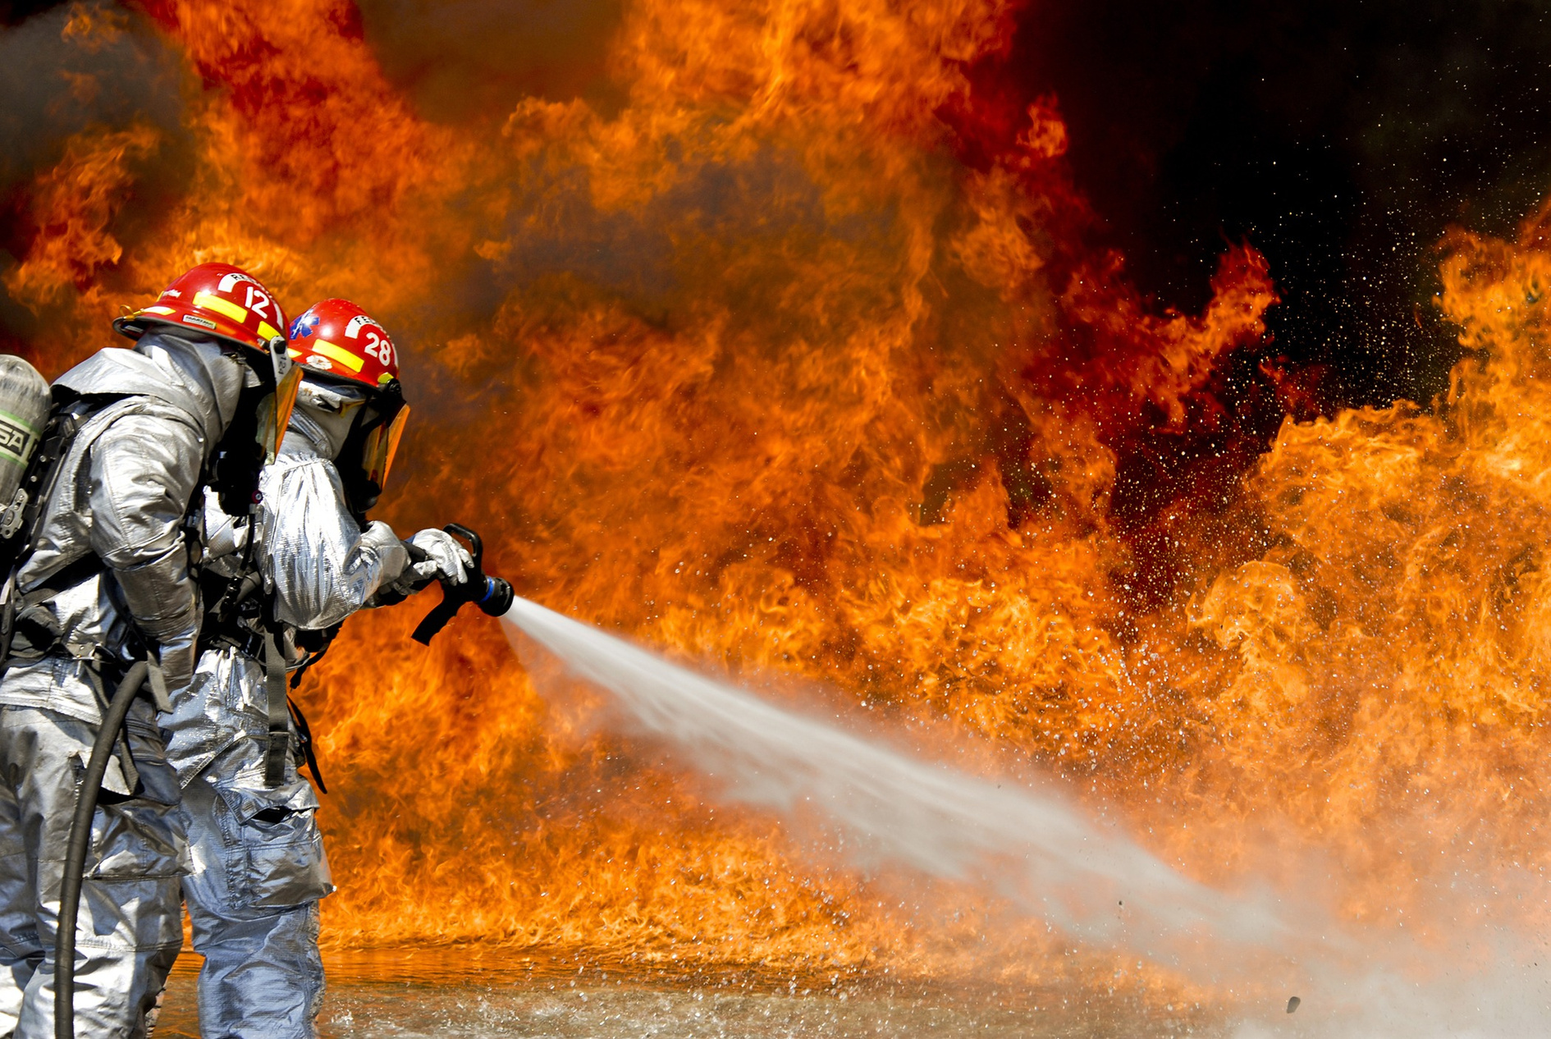
PFAS in Firefighter Turnout Gear
What is turnout gear?
Specialized protective clothing used by firefighters during emergencies, especially fire responses. It is engineered to offer thermal insulation, shield against heat and flames, and resist water and hazardous substances.
Key features: Heat and chemical resistance.
PFAS Usage in Turnout Gear: Hydrophobic coatings to repel water and chemicals
Attorney Work Product. Privileged & Confidential.

Slide 10
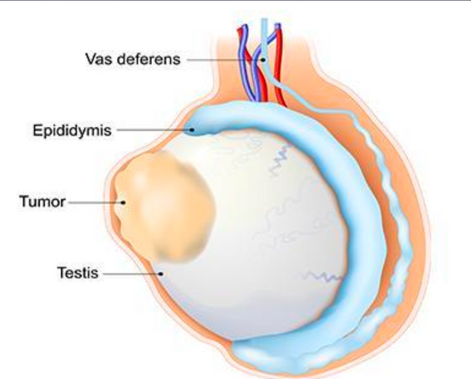
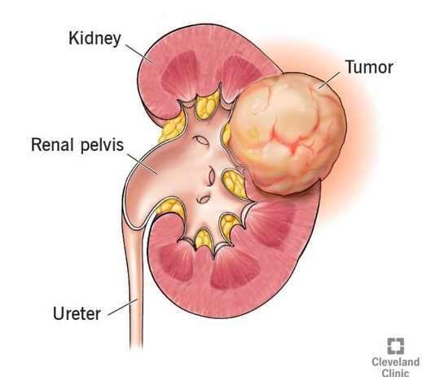
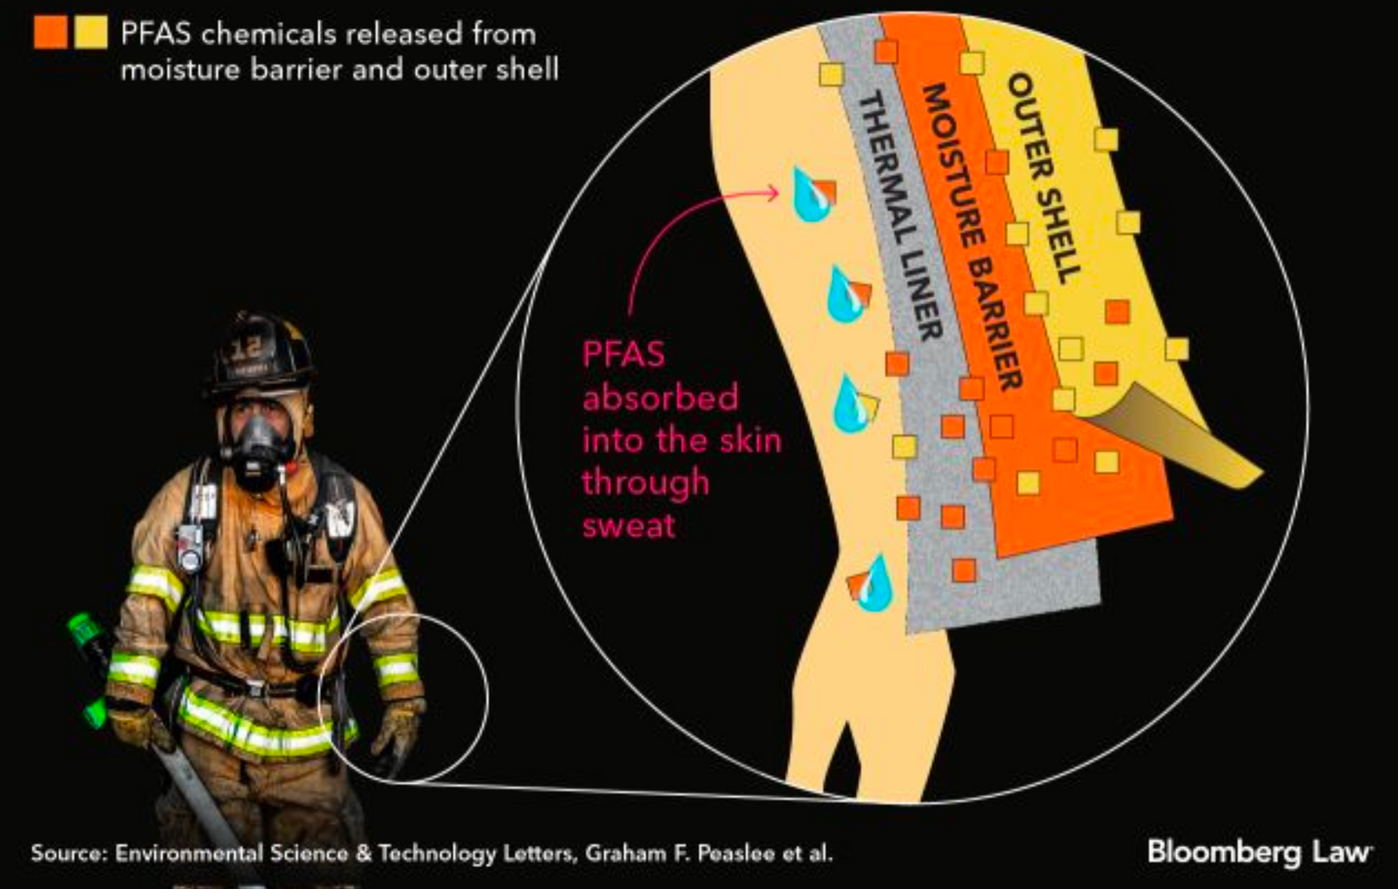
Health & Environmental Risks of PFAS
PFAS LINKED CANCERS
Other Cancers or Diseases:
Kidney Disease, Thyroid Disease; Ulcerative Colitis Bladder Cancer, Liver Cancer, Colorectal Cancer, Pancreatic Cancer, Prostate Cancer; Thyroid Cancer
TURNOUT GEAR
Research shows that PFAS can leach out of turnout gear onto fire fighters' skin
and enter their bloodstream.
Attorney Work Product. Privileged & Confidential.

Slide 11
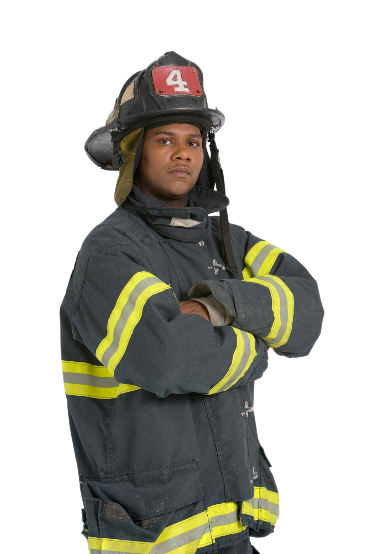
Municipal Financial Impacts
Increased healthcare claims for firefighters.
2024 Turnout Gear Cost Analysis
Turnout/Bunker Gear Costs:
  Recent estimates for the cost of PFAS-free bunker gear are $12,000 per set.
  Each fire fighter requires 2 sets of bunker gear.
  Turnout or bunker gear clothing is limited to 10 years of use per NFPA standards.
Costs to Municipalities:
  Purchase of PFAS-contaminated turnout gear
  Replacement costs
  Increased healthcare claims for firefighters.
How does this impact my County?
  Gear manufacturers are beginning to find alternatives to PFAS
  With the recent changes to NFPA Standard 1970, these alternatives will need to be found sooner
  Once PFAS-free gear becomes available, every fire fighter in every city and county in America will need to be outfitted in gear that is free of this toxic substance
  The replacement will be very costly
Attorney Work Product. Privileged & Confidential.

Slide 12

Legal Landscape
PFAS Litigation Overview:
  Lawsuits against manufacturers of PFAS and turnout gear.
  Precedents: We have successfully recovered compensation from PFAS manufacturers on behalf of municipalities and public water systems for costs associated with remediation efforts. these recoveries have provided critical financial support to address contamination, safeguard public health, and ensure access to clean and safe water.
Municipal Rights and Claims:
  Recouping costs for contaminated gear, healthcare expenses.
Attorney Work Product. Privileged & Confidential.

Slide 13

Our Role in Litigation
How we can help:
Investigating potential claims
Pursuing manufacturers for compensation.
List of Turnout Gear Defendants:
MAKERS OF FIBER AND FABRIC
  PBI Performance Products
  W.L. Gore
  Tencate Protective Fabrics (Southern Mills)
  Milliken
  Safety Components
ASSEMBLERS OF STRUCTURAL GEAR
  Fire-Dex
  Globe
  Mine Safety (MSA)
  Honeywell Safety
  Lion Group
  Stedfast
  Innotex
  Ricochet
  Veridian
  CB Garment (Gearboss)
DISTRIBUTORS
  Mallory Safety
  L.N Curtis
  Allstar Fire
  Municipal Emergency Services (MES)
  Witmer
Attorney Work Product. Privileged & Confidential.

Slide 14
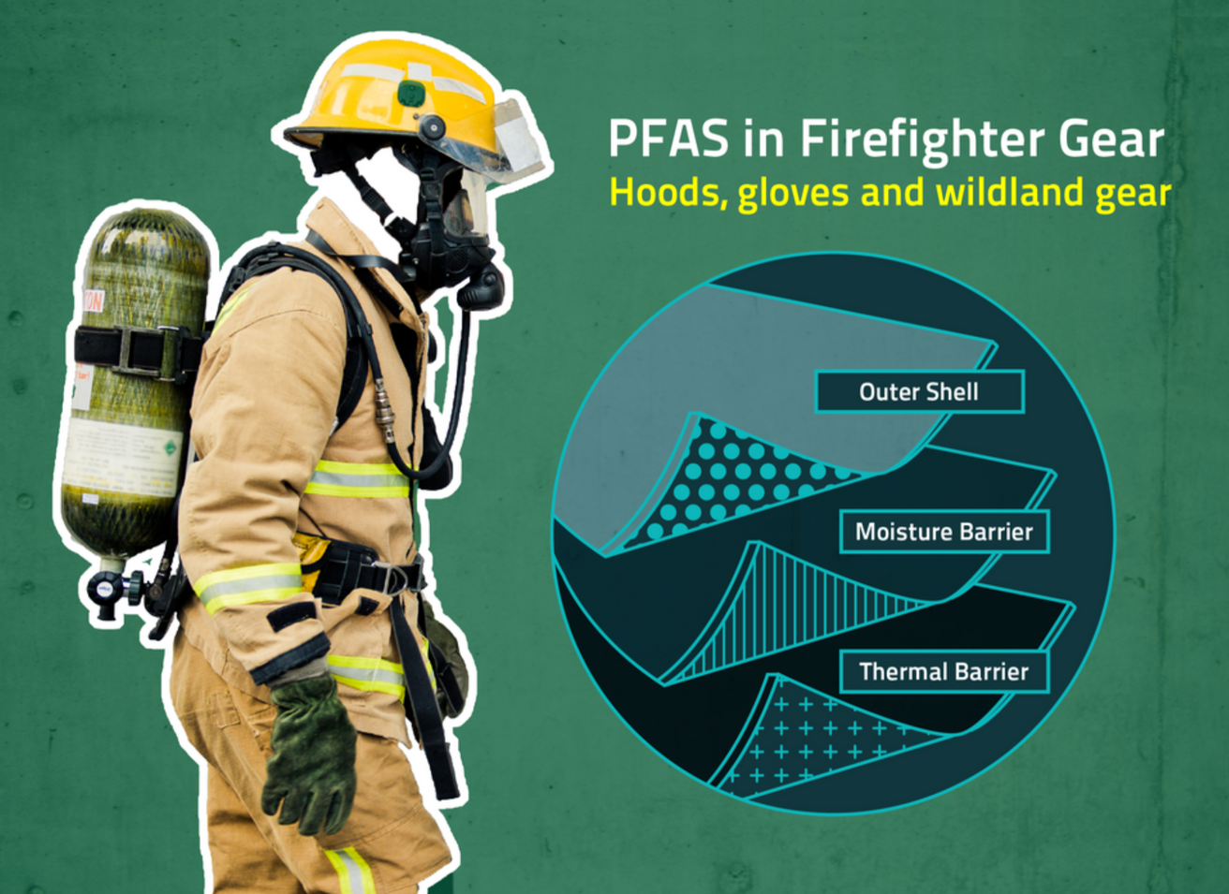
PFAS Found in Firefighter Gloves, Hoods and Wildland Gear
NIST conducted these studies at the behest of Congress, which called on NIST to study PFAS in firefighter gear in the 2021 National Defense Authorization Act.
Fabrics containing PFAS are often used to make firefighting gear because these chemicals are very good at repelling water. NIST researchers have been running a series of experiments to understand how much PFAS are in that equipment.
“Our latest study showed that PFAS are present not only in the jacket and pants worn by firefighters, but also in many of the smaller protective garments,” said NIST chemist and study co-author Rick Davis. “Measuring the presence of the chemicals is the first step in understanding their impact on firefighters.”
https://yubanet.com/scitech/pfas-found-in-firefighter-gloves-hoods-and-wildland-gear/
Firefighters have more PFAS in their blood than the average person.
Attorney Work Product. Privileged & Confidential.

Slide 15
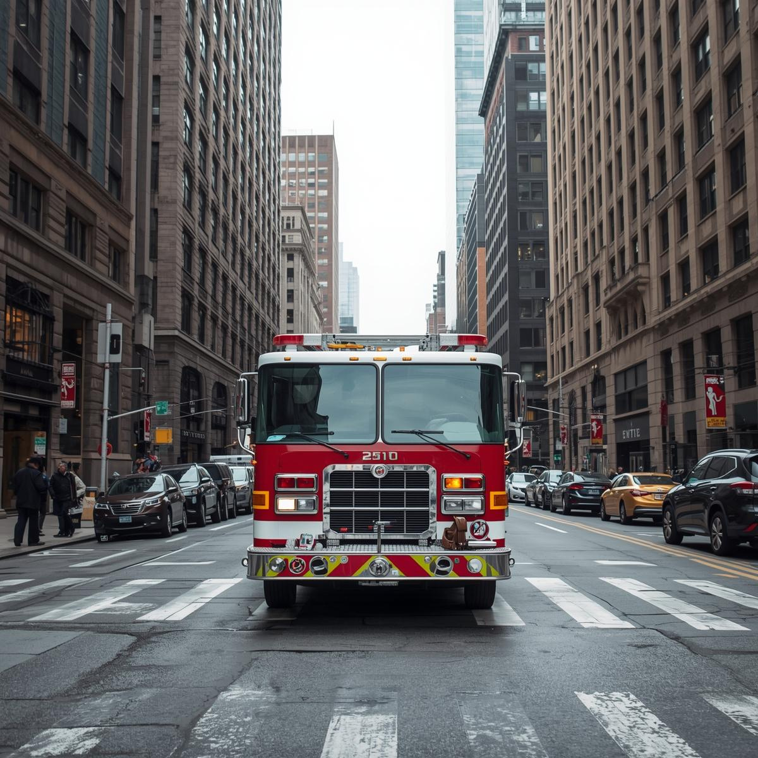
FIRETRUCK PRICING LITIGATION
Summary
Multiple municipalities have filed antitrust lawsuits against the three largest fire truck manufacturers (controlling 70-80% of the U.S. market) and their trade association, alleging a conspiracy to fix prices, suppress production, and artificially inflate costs dating back to 2016. Fire truck prices have doubled in the last decade while wait times have tripled, straining municipal budgets and creating public safety concerns.
Attorney Work Product. Privileged & Confidential.

Slide 16

THANK YOU
HANK NAUGHTON, Partner
hnaughton@napolilaw.com
(978) 852-3643
Attorney Work Product. Privileged & Confidential.

