Slide 1
August 2025
ePOLST and EMS

Slide 2
Agenda
Project Impetus
Program Mission
Project Scope
Measures of Success
ePOLST Registry
Proposed Timeline
  Phase 1
Expectations from Pilot
Next Steps
Demo and Q&A

Slide 3
Project Impetus
The MOLST (Medical Orders for Life Sustaining Treatment) process was launched in 2012. This paper-based process currently suffers from 4 major limitations:
  The form validation process is manual and there is no central repository for current MOLST information
  There is no interoperability with EHR systems used within the State, which creates an impediment to clinician adoption
  The form and the underlying clinical and administrative processes are not aligned with best practices; and the order is not transferable across care settings or state lines
  There is no standardized training for medical providers in the MOLST process
To address these gaps, Bill H. 5374, signed in 2022, mandates the State to:
  transition from the current MOLST process and form, to the National POLST Paradigm, and
  to develop, implement, and operate a statewide electronic POLST IT system.

Slide 4
Program Mission
To help persons living with serious illness and advancing frailty
engage in care planning conversations with their clinicians and care teams to ensure their treatment preferences are understood and honored.

Slide 5
Project Scope
This IT implementation and business process redesign project is focused on meeting the State’s legislative mandate seamlessly
Specifically, the project scope includes the following project outcomes:
  IT system implementation (first as a stand-alone system)
  IT system integration with provider Electronic Health Record systems
  Ongoing stakeholder engagement with internal and external stakeholders
  Education for clinicians/EMS
  Education for patients, healthcare agents, and guardians
  Data-driven Continuous Quality Improvement.

Slide 6
Measures of Success
When this project is successfully completed and the ePOLST system is operational:
  Seriously ill patients and/or their healthcare agents, in collaboration with clinicians, will be able to complete, upload and access advance care planning documents in a secure and trustworthy IT system (ePOLST)
  EMTs and paramedics will be able to view the most up-to-date documentation of patient wishes through ePOLST in real-time. This will provide a reliable source of truth in the event the patient is not able to communicate, and will inform the course of treatment when EMS responds to a 911 call for a patient who has an ePOLST
  Clinicians will capture their patient’s expressed end-of-life wishes in ePOLST which will interface with their organization’s Electronic Health Record
  EOHHS, AGE, and provider organizations will be able to base all related decisions on data gathered through the system and conduct Continuous Quality Improvement.

Slide 7
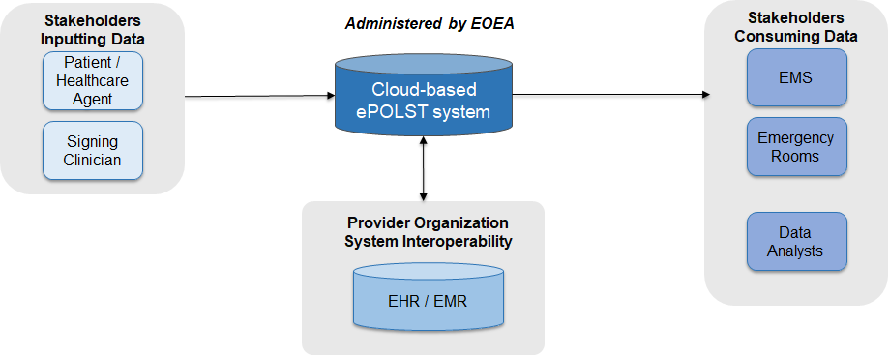
ePOLST registry
In July of 2024, EOEA procured MyDirectives, a CoTS IT system after a rigorous stakeholder engagement, business requirement gathering and RFR process.
ePOLST access options
  1. Standalone ePOLST registry
    Secure, web browser access
  2. ePOLST registry integration with EHR
    Single sign on, patient demographic sharing for account creation, EHR writeback

Slide 8
Implementation Timeline*
Q3&4 2025
EHR Integration and testing
Q4 2026
Evaluation and Refinement
Q4 2026
Begin Statewide training
2027
Begin Statewide Implementation
2027 +
Continuous Quality Improvement
Q1&2 2025
Registry Customization and Testing
2026
Go-live with Pilot sites

Slide 9
Proposed EMS Testing Approach
Collaborate with FCAM and MAA to recruit EMS testing partners – EMT/paramedics
Provide a demo to system partners (30 mn)
Provide system access to partners
Partners conduct testing and provide feedback through an online survey (ideally by September): https://www.surveymonkey.com/r/EMSePOLSTSurvey
If possible, partners remain involved for actual roll-out planning

Slide 10
Questions? Contact:
MassPOLST@mass.gov

